Slide 1
CS305
System Modeling and Simulation
Prof. Dr. Khaled Mahar
khmahar@aast.edu
Lecture 2

Slide 2
Steps in a Simulation Study
Phase I
Problem formulation: statement of the problem
Setting of objectives and overall plan: questions to be answered by the simulation
Model conceptualization: abstract the essential features of the problem, set basic assumptions that characterize the system (Specification Model), start with a simple model, enrich and elaborate the model
Data collection: start early because it may take a lot of time
Model translation: programming (Computational Model)
Verification: is the computer program functioning properly?
Validation: does the model accurately represent the system?
Phase II
Phase III
Experimental design: which alternatives (designs) to simulate
Production runs and analysis: to estimate measures of performance for the system designs that have been simulated. Measures of performance may depend on statistical analysis, e.g.: average, probability, frequency, etc.
More runs? a sufficient number is needed to guarantee statistical accuracy
Phase IV
Documentation
Implementation
Notes:
Objectives are the questions to be answered by the simulation.
Overall project plan includes the cost of the project, and number of days required to finish each phase.
Conceptual Model: Abstract essential features like Events, activities, entities, attributes.
Verification is the process of ensuring that the model behaves as intended, usually by debugging or through animation.
Validation ensures that no significant difference exists between the model and the real system. Validation can be achieved through statistical analysis. Additionally, the model can be reviewed and supported by an expert.

Slide 3
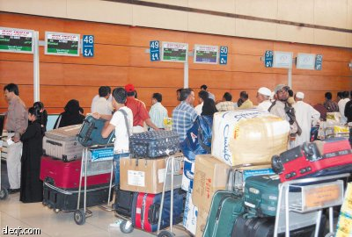
Example: Airport Check-in Desk Queuing
We consider flight check-in desks in an Airport. The administration of the airport wants to improve its quality of service by reducing the waiting time of travelers. For that purpose, they want to design what could be the best queuing strategy to have the minimum waiting time.
The problem statement: what is the best queuing strategy that reduces the waiting time of travelers in check-in desks?

Slide 4
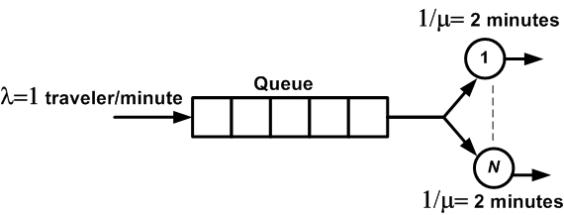
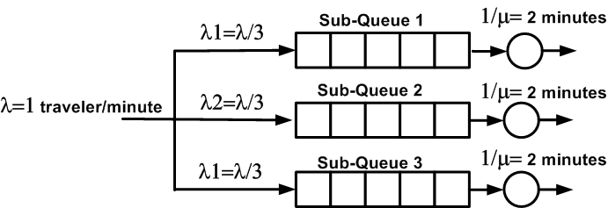
Phase I. Define the objectives of the study
Main Objective: what is the best queuing strategy that reduces the waiting time of travelers in check-in desks.
Find a model that enables to compute waiting time of travelers
Two Possible Models
Model 1
Model 2
Notes:
Solution 1. Queueing Theory (Analytical Model)
Solution 2. Simulation (Computer Program Model)

Slide 5
Phase II. Develop Conceptual Model
What are the elements of the system?
Model 1
Model 2
One Queue
N=3 servers
Three Queues
N=3 servers
Customers: travelers that arrive to the check-in desk
Servers: represents the agent (officer) that makes the flight registration
Notes:
Entity: customers

Slide 6
Phase II. Model Specification
What are the characteristics of the elements of the system?
Model 1
Model 2
One Queue:
Length= 60 Travelers
N=3 Agents
Service rate: 30 travelers/hour
Travelers arrive with a rate 1 travelers/minute
Three Queue:
Length= 20 Travelers/Queue
N=3 Agents
Service rate: 30 travelers/hour
Travelers arrive with a rate 1 travelers/minute
Travelers choose a queue with a probability of 1/3.

Slide 7
Phase II. Model Translation
Simulation model executes the logic of the conceptual model
Coding
General Purpose Language
Special Purpose Simulation Language/Software
Examples:
Examples:
JAVA, C++, Visual BASIC
SIMAN, ARENA, EXTEND

Slide 8
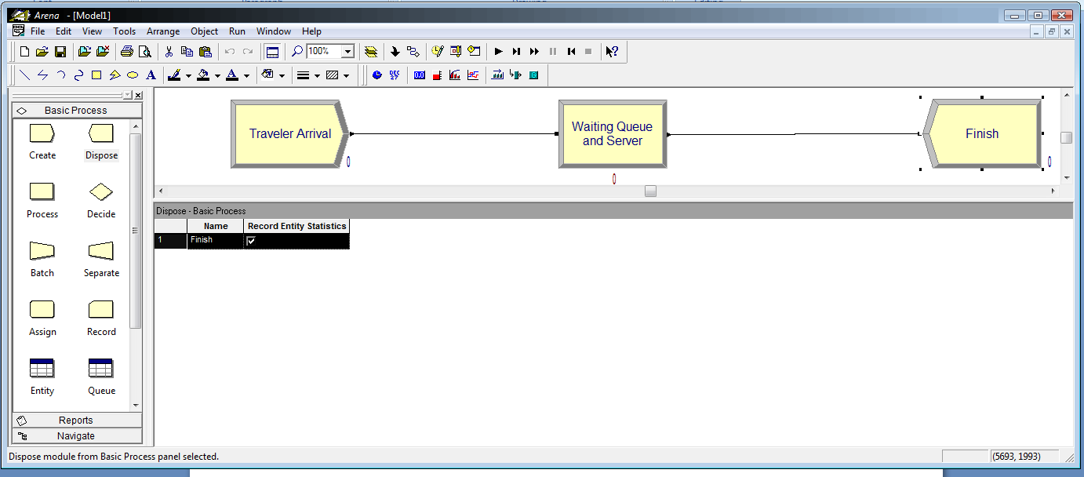
Phase II. Model Translation
Simulation Model: Arena
Model 1
Model 2
Model 1 is better than Model 2 because it has lower delay

Slide 9
Phase II. Verification and Validation
Real World System
VALIDATION
Conceptual model
Logical model
VERIFICATION
Simulation model
Notes:
Verification: the process of determining if the operational logic is correct. Debugging the simulation software or by animation to see the dynamic of the system
Validation: the process of determining if the model accurately represents the system. Comparison of model results with collected data from the real system

Slide 10
Phase II. Verification and Validation
Analytical Model: Queuing Theory
Model 1
Model 2
Model 1 is better than Model 2 because it has lower delay
Notes:
Validation
Typically, the validation of a simulation model can be done by comparing
Measurements of actual system
An analytic (mathematical) model of the system
Another simulation model
Often can only validate portions of the model
If you can validate the simulation with 100% certainty, why build the simulation?

Slide 11
Phase III. Experimental Design
Alternative scenarios to be simulated
Type of output data analysis
steady-state
terminating simulation analysis
Number of simulation runs
Length of each run

Slide 12
Phase III. Analysis of Results
Statistical tests for significance
Point Estimation
Confidence-Interval Estimation
More runs?

Slide 13
Phase IV. Documentation & Reporting
Program Documentation
Allows future modifications
Creates confidence
Progress Reports
Alternative scenarios
Performance measures or criteria used
Results of experiments
Recommendations

Slide 14
Phase IV .Implementation
?
FAILURE
SUCCESS

Slide 15
Simulation Examples

Slide 16
Learning Objectives
To understand Monte Carlo simulations and discrete event simulations (DES)
To use random numbers to represent uncertainty
To use descriptive statistics for predicting system performance in queuing and inventory models
To learn how to think in a DES model in terms of inputs, activities, events, states, outputs, and responses.

Slide 17
Types of Simulations
Variety of types, but main:
emulation,
trace driven,
Monte Carlo, and
discrete-event
Notes:
Emulation: Simulation that runs on a computer to make it appear to be something else. Examples: JVM
Trace driven: Uses time-ordered record of events on real system as input.
Example: to compare memory management, use trace of page reference patterns as input to simulate page replacement algorithms

Slide 18
Monte Carlo Simulation
A static simulation with no time parameter
Used to
model physical phenomena
evaluate probabilistic system,
numerically estimate complex mathematical expression
Driven with random number generator
Examples:
Estimating the value of π
Approximating integrals
Coin tossing problem
Simulating random service time
Notes:
Mote Carlo :A problem solving technique used to approximate the probability of certain outcomes by running multiple trial runs.
There is no events or clock times being tracked
Runs until some equilibrium state reached
Physical phenomena: thermal scattering, and pressure.
Probabilistic system: investment under different states of economy.

Slide 19
Monte Carlo Simulation: Estimating π value
Imagine throwing dart at square
Random x (0,1)
Random y (0,1)
Count if inside
sqrt(x²+y²) < 1
Compute ratio
R = in / (in + out)
Can repeat as many times as needed to get arbitrary precision
Unit square area of 1
Ratio of area of circle quarter to area in square = π /4
(Show solution)
Notes:
Since the radius is 1, the circle area is π
R is the area of the circle quarter

Slide 20
Monte Carlo Simulation: Approximating Integrals
Consider the integral
Making the substitution
we get
where

Slide 21
Monte Carlo Simulation: Approximating Integrals (cont.)
Let Y ~ uniform(0,1)
Approximate the integral by simulation
(Show solution)
Notes:
The uniform distribution in the range [0,1] has a probability density function f(x)=1
The integration in the green box can be approximated by summation by law of large numbers

Slide 22

Monte Carlo Simulation: Coin Tossing Problem
Simulate a sequence of 20 coin tosses
The coin is fair
Possible outcomes: Head (H) or Tail (T)
Probability of each outcome = 0.5
The outcome is random
Use random number generator to simulate the outcome
Run the simulation multiple times and compare with what you expect from real life coin tossing

Slide 23
Each game is 20 tosses
Trial | Random Number | Outcome
1 | 0.508915 | T
2 | 0.09472 | H
3 | 0.065781 | H
4 | 0.25237 | H
5 | 0.319891 | H
6 | 0.872435 | T
7 | 0.769015 | T
8 | 0.029574 | H
9 | 0.434484 | H
10 | 0.098912 | H
11 | 0.894552 | T
12 | 0.949284 | T
13 | 0.0471 | H
14 | 0.099085 | H
15 | 0.714421 | T
16 | 0.783722 | T
17 | 0.830271 | T
18 | 0.928788 | T
19 | 0.961181 | T
20 | 0.011616 | H
 | No. of Heads | 10
 | No. of Tails | 10
Toss coin 20 times
Excel function RAND() produces random numbers in the range [0,1]
IF(RAND() ≤ 0.4999, “H”, “T”)
COUNTIF(range, “H”)

Slide 24
Play the game 20 times
Trial | Random Number | Outcome |  |  |  | Play | Heads | Tails
1 | 0.814852 | T |  |  |  | 1 | 7 | 13
2 | 0.7161 | T |  |  |  | 2 | 11 | 9
3 | 0.731665 | T |  |  |  | 3 | 9 | 11
4 | 0.517831 | T |  |  |  | 4 | 10 | 10
5 | 0.290017 | H |  |  |  | 5 | 6 | 14
6 | 0.004523 | H |  |  |  | 6 | 8 | 12
7 | 0.252193 | H |  |  |  | 7 | 10 | 10
8 | 0.595402 | T |  |  |  | 8 | 9 | 11
9 | 0.935727 | T |  |  |  | 9 | 13 | 7
10 | 0.512231 | T |  |  |  | 10 | 9 | 11
11 | 0.804089 | T |  |  |  | 11 | 14 | 6
12 | 0.55115 | T |  |  |  | 12 | 11 | 9
13 | 0.311842 | H |  |  |  | 13 | 8 | 12
14 | 0.632167 | T |  |  |  | 14 | 12 | 8
15 | 0.770659 | T |  |  |  | 15 | 13 | 7
16 | 0.570808 | T |  |  |  | 16 | 5 | 15
17 | 0.924646 | T |  |  |  | 17 | 7 | 13
18 | 0.029194 | H |  |  |  | 18 | 15 | 5
19 | 0.304884 | H |  |  |  | 19 | 12 | 8
20 | 0.913713 | T |  |  |  | 20 | 9 | 11
 |  |  |  |  |  | Average | 9.9 | 10.1

Slide 25
Coin Tossing Problem (cont.)
This is a Monte-Carlo simulation because there are no events or clock times being tracked
The model is the idea:
if the generated random number is less that 0.5 we got a Head and otherwise we got a Tail
The measure of performance may be the frequency of occurrence as in the coin simulation table or the average of occurrence as in the game replication table

Slide 26
Monte Carlo Simulation: Simulating Random Service Times
An automated telephone information service spends either 3, 6, or 10 minutes with each caller. The proportion of calls for each service length is 30%, 45%, and 25%, respectively
Simulate these service times for 10 callers in a spreadsheet

Slide 27
Simulating Random Service Times (cont.)
In a discrete distribution, the length of an interval is proportional to its probability of occurrence
Probabilities
0.30
0.45
0.25
Cumulative Probabilities
0.30
0.75
1
Service Times (minutes)
3
6
10

Slide 28
Simulating Random Service Times (cont.)
Service Time | Probability | Cumulative Probability
3 | 0.3 | 0.3
6 | 0.45 | 0.75
10 | 0.25 | 1
 | Solution using (IF)
Caller | Random Number | Random Service Time
1 | 0.928164 | 10
2 | 0.41826 | 6
3 | 0.687004 | 6
4 | 0.701029 | 6
5 | 0.697156 | 6
6 | 0.352523 | 6
7 | 0.813737 | 10
8 | 0.895322 | 10
9 | 0.696447 | 6
10 | 0.303053 | 6
IF(N9≤0.3,3,IF(N9≤0.75,6,10))

Slide 29
Discrete-event Simulation
Modeling of a system as it evolves over time by a representation where the state variables change instantaneously at separated points in time
These points in time are when events occur
Event: Instantaneous occurrence that may change the state of the system
Simulation clock: Variable that keeps the current value of (simulated) time in the model
Notes:
Modeling of dynamic system

Slide 30
Simple Single Channel Queuing System
Calling Population
Server
Waiting Line
Unlimited potential calling population
Constant arrival rate, inter-arrival times follow the same statistical distribution
Arrivals for service occur one at a time in a random manner
Once units join the queue they will eventually be served
Service times are random according to a probability distribution
The system capacity has no limit.
Units are served in First In First Out (FIFO) or First Come First Served (FCFS)
Single server or multiple parallel servers
Notes:
constant arrival rate: no matter how many units arrived or are still in the system.
The system capacity has no limit: the queue can be infinite
Important Note: For any single or multi-channel queue, arrival rate must be lower than the service rate. Otherwise, the waiting line will grow without bound and the system becomes “explosive” or “unstable

Slide 31
System State, Events and Simulation Clock for a Queuing Model
System state:
Number of units in the system
Server status: busy or idle
Events:
Arrival event
Departure event, i.e. service completion
Failure Event – server failure
Repair Event – server repair
The simulation clock is used to track simulation time

Slide 32
Arrival Event
Arrival event
Schedule next arrival
Increase number in the system
L(t)=L(t)+1
NO
Is
server
busy?
YES
Make server busy
Increase entity number
in queue
B(t)=1
Q(t)=Q(t)+1
Set service time &
schedule departure

Slide 33
Service Completion Event
Departure event
Decrease number in system
L(t)=L(t)-1
NO
Is
queue
empty?
YES
Decrease number in
queue
Make server idle
Q(t)=Q(t)-1
B(t)=0
Set service time &
scheduled departure for
entity in service

Slide 34
Example of Single Server Queue Simulation
A small grocery store has one check out counter. Customers arrive at the check counter at random times that range from 1 to 8 minutes apart. Assume that inter-arrival times are integer valued, with each of the 8 values having equal probability. The service times vary from 1 to 6 minutes – also integer valued – with probabilities shown in the table below
Analyze the system by simulating the arrival and departure of 100 customers. Compute the measures of performance of the queuing model
Service Times (min) | Probability | Cumulative Probability
1 | 0.10 | 0.10
2 | 0.20 | 0.30
3 | 0.30 | 0.60
4 | 0.25 | 0.85
5 | 0.10 | 0.95
6 | 0.05 | 1.00

Slide 35
Model Responses and Simulation Table for the Grocery Store Simulation
Totals | 437 |  |  | 327 |  | 132 |  | 459 | 112
Averages | 4.37 |  |  | 3.27 |  | 1.32 |  | 4.59 | 1.13
Total number of customers = 100
Step | Activity |  | Clock | Activity | Clock | Output | Clock | Output | Output
Customer | Interarrival time (min) |  | Arrival time | Service time (min) | Time service begins | Waiting time in queue (min) | Time service ends | Time customer spends in system | Idle time of server
1 | 0 |  | 0 | 3 | 0 | 0 | 3 | 3 | 0
2 | 8 |  | 8 | 3 | 8 | 0 | 11 | 3 | 5
3 | 8 |  | 16 | 5 | 16 | 0 | 21 | 5 | 5
4 | 4 |  | 20 | 3 | 21 | 1 | 24 | 4 | 0
5 | 2 |  | 22 | 4 | 24 | 2 | 28 | 6 | 0
6 | 1 |  | 23 | 2 | 28 | 5 | 30 | 7 | 0
7 | 3 |  | 26 | 3 | 30 | 4 | 33 | 7 | 0
8 | 7 |  | 33 | 2 | 33 | 0 | 35 | 2 | 0
9 | 2 |  | 35 | 5 | 35 | 0 | 40 | 5 | 0
10 | 1 |  | 36 | 4 | 40 | 4 | 44 | 8 | 0
11 | 5 |  | 41 | 5 | 44 | 3 | 49 | 8 | 0

Slide 36
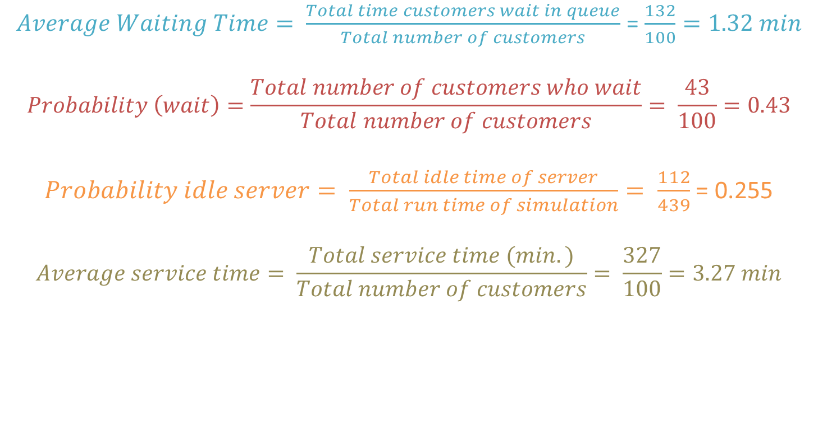
Typical Performance Measures of a Queuing System
$Average Waiting Time= \frac{Total time customers wait in queue}{Total number of customers}$ = $\frac{132}{100}=1.32 min$
$$Probability \left(wait\right)=\frac{Total number of customers who wait}{Total number of customers}= \frac{43}{100}=0.43$$
$Probability idle server= \frac{Total idle time of server}{Total run time of simulation}= \frac{112}{439}$ = 0.255
$$Average service time= \frac{Total service time (min.)}{Total number of customers}= \frac{327}{100}=3.27 min$$

Slide 37
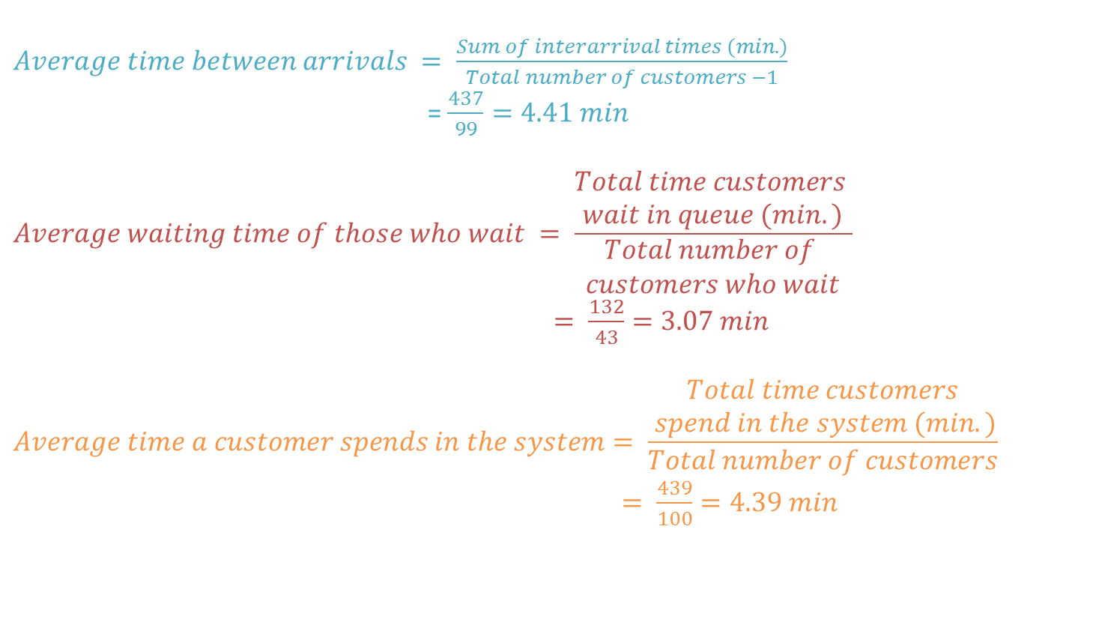
Typical Performance Measures of a Queuing System
$Average time between arrivals = \frac{Sum of interarrival times (min.)}{Total number of customers −1}$
= $\frac{437}{99}=4.41 min$
$$Average waiting time of those who wait = \frac{\begin{aligned}Total time customers \\ wait in queue (min.)\end{aligned}}{\begin{aligned}Total number of \\ customers who wait\end{aligned}}$$
$= \frac{132}{43}=3.07 min$
$$Average time a customer spends in the system= \frac{\begin{aligned}Total time customers \\ spend in the system (min.)\end{aligned}}{Total number of customers}$$
$= \frac{439}{100}=4.39 min$

Slide 38
Typical Performance Measures of a Queuing System
Average time a customer spends in the system =
average time a customer waits in queue +
average time a customer spends in service
= 1.32 + 3.27
= 4.59 min

Slide 39
Typical Performance Measures of a Queuing System

Slide 40
Typical Performance Measures of a Queuing System
The experiment was run 50 times, each trial represents one day
Notes:
Vertical axis represent No. of trials. So the 1st column shows that the average waiting time is 0.5 minutes for one trial.

